Slide 1
MITIGATING BIAS IN MACHINE LEARNING (TENSOR FLOW FAIRNESS INDICATORS IN CREDIT RISK PREDICTION)
Andridge Munene Ngare
Computer Technologist
22nd Oct 2023

Slide 2
INTRODUCTION
Machine learning bias can be defined as the unfair and discerning outcomes that could develop in prediction models as a result of biased training data or algorithmic decisions.
Bias can lead to unfair lending practices in the setting of credit risk prediction models, affecting loan and mortgage applications and influencing who gets approved or rejected for financial services.
Establishing unbiased credit risk prediction models is crucial for establishing a more equitable world. It encourages fair access to financial services, responsible lending, and individual and institutional financial stability.

Slide 3
Several de-biasing strategies can be used to address bias in credit risk prediction models. These could include:
Reweighting the Dataset: This is the process of adjusting the weights of training instances to reduce bias.
Pre-processing is the process of modifying input properties in order to eliminate bias-related fluctuations.
Post-processing is the process of adjusting model outputs to ensure fairness.

Slide 4
LITERATURE REVIEW
Historical Bias in credit scoring is caused by past discriminatory practices, which results in skewed training data. For example, if certain populations have previously been unfairly rejected loans, their credit histories may deteriorate, continuing prejudice in lending models.
Representation When credit datasets do not adequately represent the applicant population, bias occurs. Because the dataset may over- or under-represent specific demographic groups, this might lead to biased model results.

Slide 5
CREDIT SCORING:
Recall Algorithm by Wu, Huang, and Duan: a high recall indicates that the model is effective at capturing all of the customers who are truly creditworthy. However, focusing solely on recall may result in an increase in false positives, implying that the model may approve credit for some who are not creditworthy. As a result, it must be balanced with precision, which is the model's ability to correctly identify positive cases while rejecting too many false ones.

Slide 6
F1-Score: attempts to strike a balance between precision and recall. Precision measures how accurate the model is at identifying positive cases, while recall measures how well it captures all positive cases. The following formula is used to calculate the F1-Score:
F1-Score = (Precision * Recall) / (Precision + Recall)
The F1-Score is a number between 0 and 1, with higher values indicating a better balance of precision and recall. It is especially useful when looking for a model that not only correctly identifies positive cases but also minimizes false positives and false negatives. It is a useful metric for determining how well a model can make accurate positive predictions while avoiding missing too many positive cases or incorrectly labeling too many negative cases.

Slide 7
ETHICAL ISSUES:
This includes ensuring that bias reduction techniques do not exacerbate existing inequalities or negatively impact marginalized groups. Balancing fairness and accuracy can be difficult, and decision-making transparency is required.

Slide 8
SOCIAL ISSUES:
It addresses the possibility of discrimination in areas such as hiring, lending, and criminal justice. Social issues concern who benefits from AI systems and who bears the costs of any remaining biases.

Slide 9
LEGAL ISSUES:
Failure to mitigate bias can result in legal liabilities, fines, and reputational harm for businesses. Compliance with legal requirements is a top priority.

Slide 10
PROFESSIONAL ISSUES:
These concerns are about keeping up with changing ethical standards, adhering to professional codes of conduct, and navigating the complex landscape of fairness and bias in AI. It necessitates ongoing professional development as well as ethical decision-making.

Slide 11
Random Forest Model (Before Bias - Mitigation)
We'll walk through the steps of writing and running a Python script to generate a synthetic credit risk dataset in this presentation. It consists of 'Age,' 'Gender,' 'Income,' and 'CreditScore.‘
Create a Python script (cv_1.py). You can use your favorite code editor or IDE for this.
The code generates synthetic data for the credit risk dataset
Run the script ('python cv_1.py‘) to generate credit_risk_dataset.csv.

Slide 12
We'll go over how to write and run a Python script to build and evaluate a credit risk model. Based on a given dataset i.e. credit_risk_dataset.csv, this model will assist us in predicting credit approvals.
Begin by importing the Python libraries that are required. Pandas for data manipulation, scikit-learn for machine learning, and others.“
Now, we'll use pandas to load our credit risk dataset. This dataset includes information such as age, gender, income, credit score, and whether or not a credit application was approved.
For our machine learning model, categorical variables, such as 'Gender,' must be encoded. LabelEncoder is used to convert 'Gender' into numerical values.
We then divided our dataset into two parts." 'X' represents the characteristics (age, income, credit score), and 'y' represents the target variable ('Approved' or 'Not Approved').

Slide 13
To test our model, we divide the data into two sets: training and testing. We use 80% for training and 20% for testing to ensure consistent results with the 'random_state' parameter.
We chose a Random Forest Classifier for this presentation. We start the model,'model,' and train it with the training data.
We use our trained model to make predictions on the test data now that it has been trained. The predicted credit approval outcomes are stored in 'y_pred‘.
We calculate accuracy and generate a classification report to evaluate the model's performance. The accuracy of our model tells us how often our predictions are correct. The classification report contains more specific information.

Slide 14
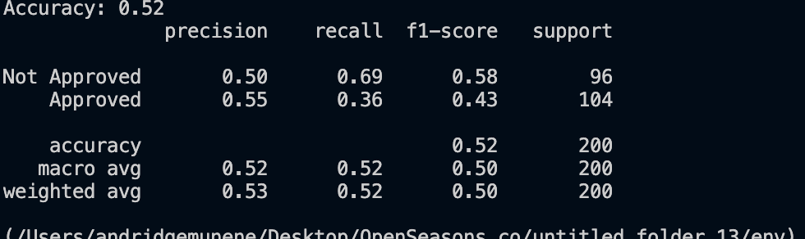
Finally, we show the evaluation results for our model: accuracy and the classification report with precision, recall, and F1-score for the 'Not Approved' and 'Approved' classes.
Random Forest Model report:

Slide 15
Fairness Metrics (Before Bias Mitigation)
Disparate Impact: This value quantifies whether the privileged and unprivileged groups have different favorable outcomes. A value near one indicates fairness.
Equal Opportunity Difference: This metric determines whether or not there is a disparity in equal opportunity (true positive rate) between privileged and underprivileged groups. A value near zero indicates fairness.

Slide 16
Random Forest Model (After Reweighing - Bias Mitigation)
We'll use Python to create, train, and evaluate a credit risk prediction model while addressing potential bias. We will also use AIF360, a fairness in AI toolkit, to assess and mitigate bias.
We include important libraries like Pandas, NumPy, Scikit-Learn, TensorFlow, and AIF360. These libraries will assist us in loading data, building models, and determining fairness.
We start by loading the credit risk dataset using Pandas
We then define the features, such as 'Age,' 'Gender,' 'Income,' and 'CreditScore,' as well as labels that represent credit approval ('Approved' or 'Not Approved').

Slide 17
To evaluate our model, we divided the data into training and testing sets. We use 80% of the data for training and 20% for testiibility.We use 80% of the data for training and 20% for testing, ensuring reproducibility with a 'random_state' parameter.
We initiate a Random Forest model and train it with the training data. The model will later be evaluated in its initial state.
We evaluate the Random Forest model by generating a classification report that provides key performance metrics like precision, recall, and F1-score.
To address bias, we create a BinaryLabelDataset for AIF360. We specify privileged and unprivileged groups based on the 'Gender' attribute, and label the 'Approved' as the favorable outcome.

Slide 18
We calculate various fairness metrics, including 'Disparate Impact' and 'Equal Opportunity Difference,' using AIF360. These metrics help us identify potential bias in the dataset.
We check the dataset for 'Disparate Impact,' which measures bias in favoring one group over another, and 'Equal Opportunity Difference,' which identifies the difference in true positive rates between groups.
To mitigate bias, we use 'Reweighing' from AIF360. This algorithm adjusts sample weights to ensure fair treatment for all groups. This can help reduce bias in model predictions.
We retrain the Random Forest model using the transformed dataset and assess its performance
We evaluate the retrained model by generating a new classification report to see how the reweighing process has affected model performance

Slide 19
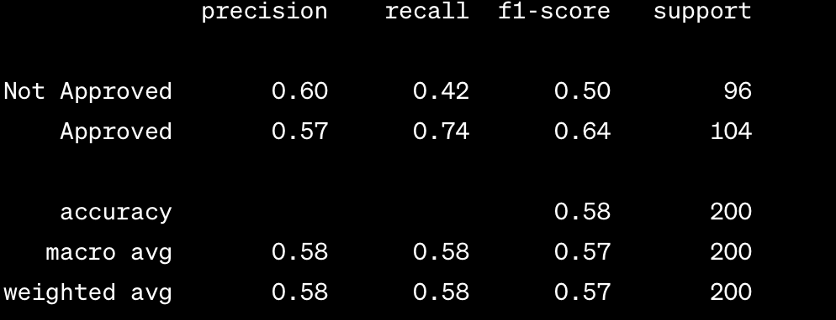
Finally, we show the evaluation results for our model
Random Forest Model report After Reweighing –Bias Mitigation:

Slide 20
THE END

